Slide 1
Metadata in Theory & Practice (LIS562) Session 1
Prof. Jerome McDonough

Slide 2
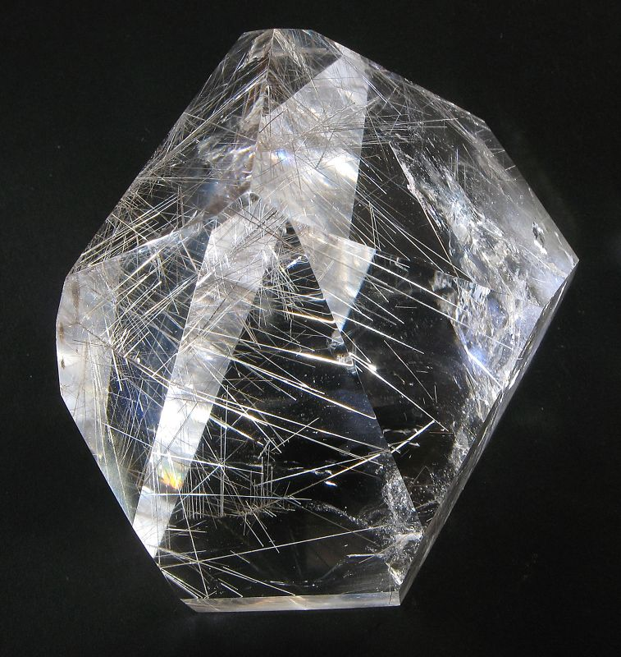
What Is Metadata?
http://www.flickr.com/photos/40635353@N00/2769991647/sizes/o/
Image made available by Ratadel under Creative Commons License.

Slide 3
What Is Metadata?
Information:
About some other form of communication;
In a structured format;
Designed to serve a particular purpose; and
Which may serve in some circumstances as a surrogate for the original communication.

Slide 4
What Is Metadata?
Metadata’s value is determined by its usefulness for particular applications, including:
FRBR Goals: Find, Identify, Select, Obtain
Organization & Management of Materials

Slide 5
What Is Metadata
Metadata forms:
Descriptive
Administrative
Technical
Intellectual Property Rights & Permissions
Digital Preservation / Provenance
Structural

Slide 6
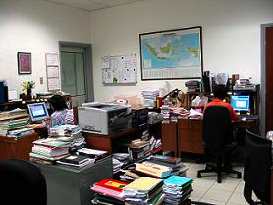
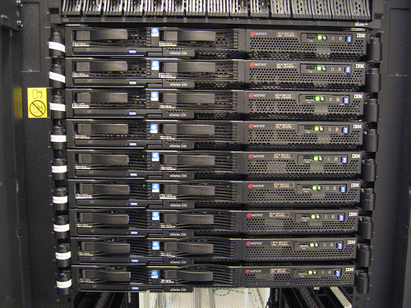
Who Creates Metadata?

Slide 7


A Bit About XML
http://oreilly.com/catalog/9780596004200
http://oreilly.com/catalog/9780596002527/

Slide 8
A Bit About XML
<?xml version="1.0" encoding="UTF-8"?><!-- XML Declaration -->
<test uselessAttribute="yes">Hello World! &amp; welcome to LIS590MDL.</test>

Slide 9
A Bit About XML & DC
<?xml version="1.0" encoding="UTF-8"?>
<xs:schema xmlns:xs="http://www.w3.org/2001/XMLSchema"
xmlns:dc="http://purl.org/dc/elements/1.1/"
elementFormDefault="qualified attributeFormDefault="unqualified”>
<xs:annotation>
<xs:documentation xml:lang="en">
Simple DC container XML Schema
Created 2003-04-02 by Tim Cole (t-cole3@uiuc.edu), Tom Habing
(thabing@uiuc.edu), Jane Hunter (jane@dstc.edu.au), Pete Johnston
(p.johnston@ukoln.ac.uk), Carl Lagoze (lagoze@cs.cornell.edu)
This schema declares a container element for a Simple DC application.
The declaration of the simpledc element uses the dc:elementContainer
complexType. Note that this schema does not define a target namespace.
The expectation is that the simpledc element is assigned to a
namespace by an application schema which includes this schema.
</xs:documentation>
</xs:annotation>
<xs:import namespace="http://purl.org/dc/elements/1.1/"
schemaLocation="dc.xsd"/>
<xs:element name="simpledc" type="dc:elementContainer"/>
</xs:schema>

Slide 10
A Bit About XML & DC
The Basic Simple Dublin Core Schema
http://www.dublincore.org/schemas/xmls/qdc/2006/01/06/dc.xsd

Slide 11

A Bit About XML & DC
http://www.amazon.com/Metadata-Fundamentals-Librarians-Priscilla-Caplan/dp/0838908470/102-0746262-7140948?ie=UTF8&s=books
<?xml version="1.0" encoding="UTF-8"?> <simpledc xmlns:xsi="http://www.w3.org/2001/XMLSchema-instance" xmlns:dc="http://purl.org/dc/elements/1.1/"
xsi:schemaLocation="http://purl.org/dc/elements/1.1/
http://dublincore.org/schemas/xmls/qdc/2006/01/06/simpledc.xsd”> <dc:creator>Priscilla Caplan</dc:creator> <dc:title>Metadata Fundamentals for All Librarians</dc:title> <dc:date>2003</dc:date> <dc:format>28 cm.</dc:format> <dc:identifier>978-0838908471</dc:identifier> <dc:language>en</dc:language> <dc:publisher>American Library Association</dc:publisher> <dc:rights>Copyright (c) 2003 Priscilla Caplan</dc:rights> <dc:subject>Metadata</dc:subject> <dc:subject>Information organization</dc:subject> </simpledc>

Slide 12
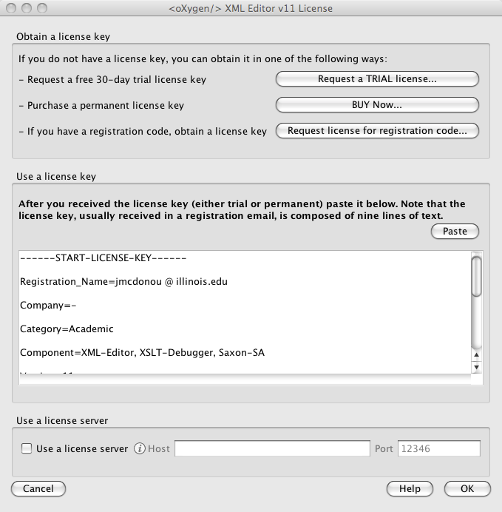
Bringing Up Oxygen

